Slide 1
Node, native code and Couchnode

Slide 2

Philipp Fehre
Twitter: @ischi
Github: @sideshowcoder
Developer Advocate, Couchbase
Notes:
- Been doing node.js since some time and C longer

Slide 3
Node.js and native code
Using C/C++ from node

Slide 4
Why would I want to do this?
Notes:
Ask audience

Slide 5
Of course Speed!

Slide 6
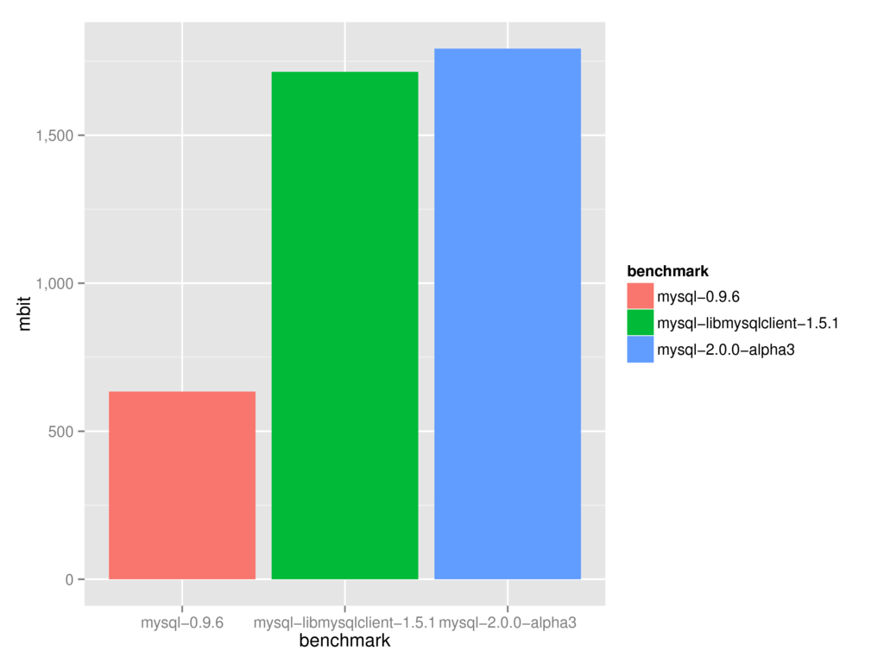
Nope…
Notes:
node-mysql is at about the same level as libmysql based drivers
Felix Geissendörfer talked about that the difference is not that big
Moving objects across the boundry is expensive

Slide 7
C is cool!
… and C++ as well
Notes:
Well if you think so

Slide 8
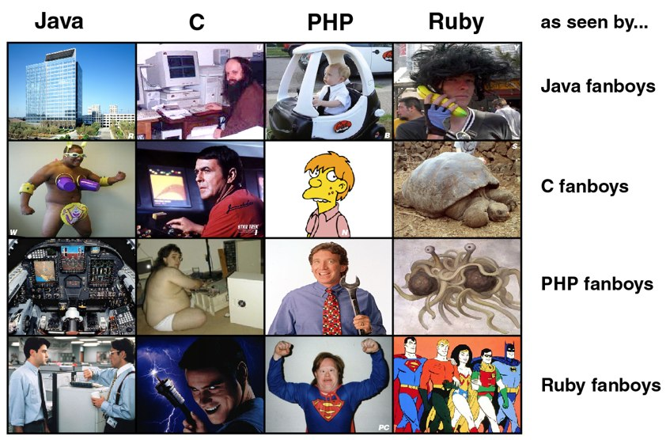
Depends on your point of view…
Notes:
It’s a matter of taste I guess
Sorry no JavaScript in here

Slide 9
Using a C library from node.js
Probably the best reason
Notes:
There is FFI but it has significant overhead
Using FFI outside your own stuff is difficult (different machines and compilers and compatibility)

Slide 10
Couchnode is one of those cases
Based on libcouchbase + wrapper

Slide 11
Quick: What’s Couchbase?

Slide 12
A Document Database.
Notes:
- Ok everybody knows everything now right?

Slide 13


Notes:
Founders were users and contributers to memcached
They build membase -> make memcache persistent and useable as a Database
Merge with Couchone to build Couchbase

Slide 14
Focus on Performance
Allow flexibility by running JS
Notes:
Build in Memcache layer -> most ops happen in RAM
CouchDB views for indexes
Ok let me show you quickly how to use the views

Slide 15
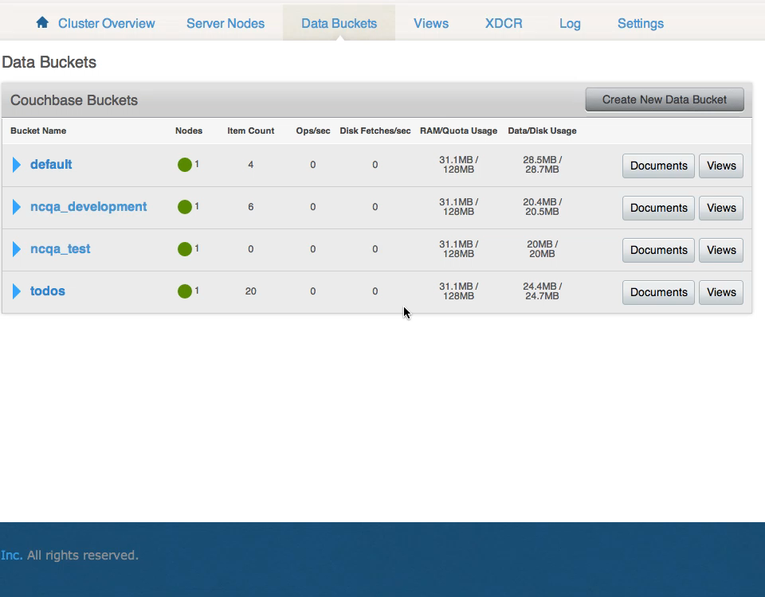
Notes:
Cool so we can create functions to index

Slide 16
Using it from node.js

Slide 17
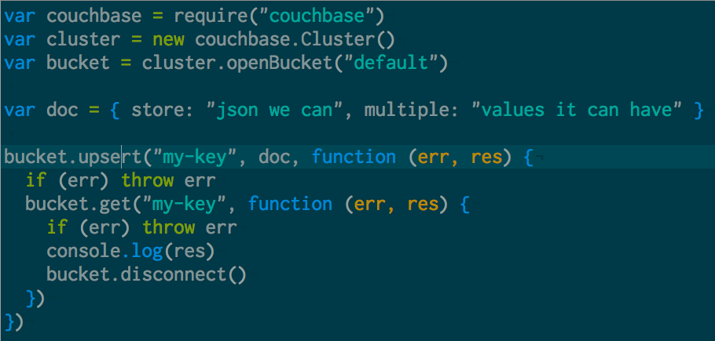
Notes:
Mostly like any database you know
It can store JSON … HEYA!

Slide 18
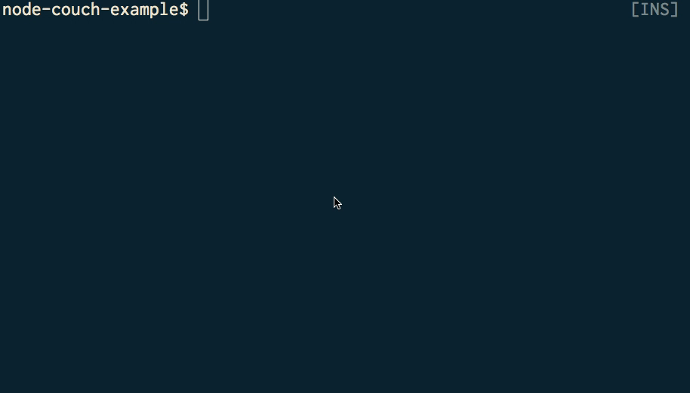
Notes:
Lets see it in action
Cool nothing special except cas

Slide 19
What happens here?
Notes:
- Lets finally see some C code

Slide 20
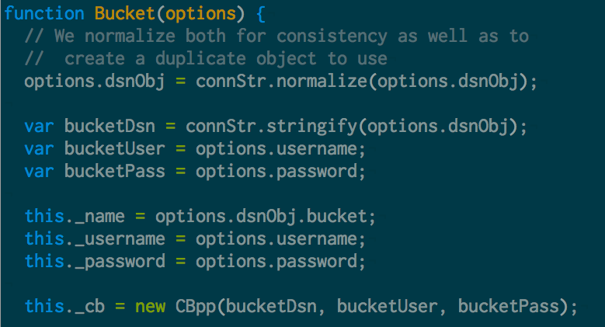
Notes:
- bucket.js
- new CBpp(…) where does it come from?

Slide 21
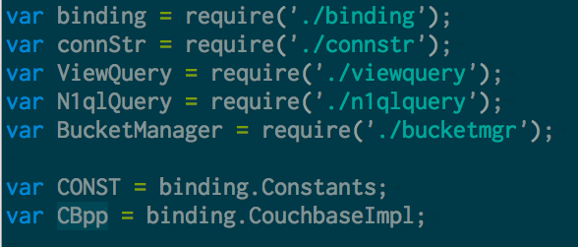
Notes:
Ok so there is a binding still bucket.js
If we now search where it comes from we will see it unltimatly comes form binding.cc
It loads couchbase_impl

Slide 22
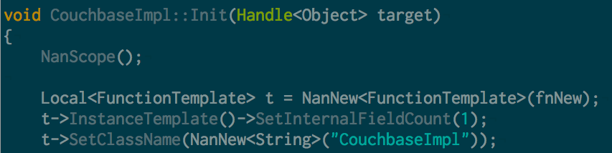
Notes:
Lets take a look what happens in the binding.cc
The init function is probably called when we load it
A new function is set…

Slide 23
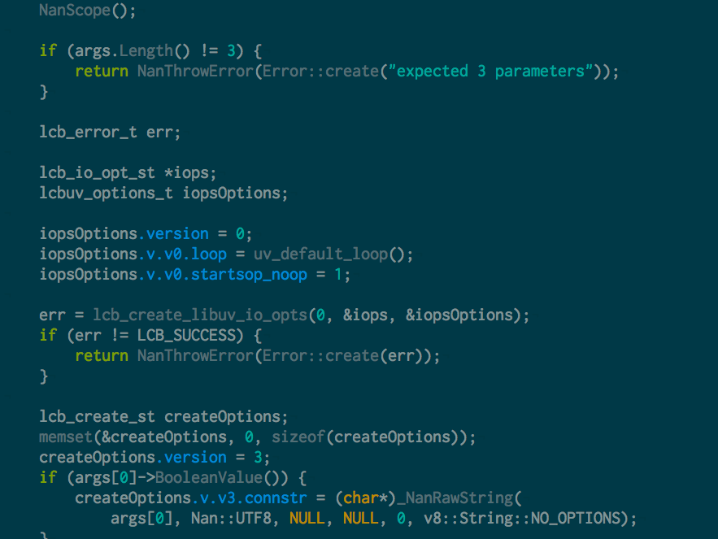
Seriously I like to show code
But this starts to be a little much
Notes:
Ok so new does a bunch of stuff
I would have loved to show you more of the internals of couchnode but I think this is not really helpful
So lets rather look at how to read couchnode by exploreing how to build a native extension

Slide 24
The hello world of extension
Notes:
Live code!
---------------------------------------------------------------------
hello extension
$ npm install -g node-gyp
--- binding.gyp
{
"targets": [
{
"target_name": "hello",
"sources": [ "hello.cc" ]
},
]
}
$ node-gyp rebuild
---- index.js
var hello = require("./build/Release/hello")
console.log(hello.world())
$ node-gyp rebuild && node index.js
---- hello.cc
#include <node.h>
#include <v8.h>
using namespace v8;
Handle<Value> world(const Arguments& args) {
HandleScope scope;
return scope.Close(String::New("hello world"));
}
void init(Handle<Object> target) {
NODE_SET_METHOD(target, "world", world);
}
NODE_MODULE(hello, init);
—- binding.gyp with nan
{
"targets": [
{
"target_name": "hello",
"sources": [ "hello.cc" ],
"include_dirs": [ "<!(node -e \"require('nan')\")" ]
},
]
}
—- hello.cc for nan
#include <node.h>
#include <v8.h>
#include <nan.h>
using namespace v8;
NAN_METHOD(world) {
NanScope();
NanReturnValue(String::New("hello world"));
}
void init(Handle<Object> target) {
NODE_SET_METHOD(target, "world", world);
}
NODE_MODULE(hello, init);

Slide 25
0.10 vs 0.11
Everything changes, welcome to the world of nan
Notes:
Method signiture changed
A bunch of other stuff changed… so better move to nan
Couchnode moved all the missing parts over as well
Big thanks to Rod Vagg!!!!!

Slide 26
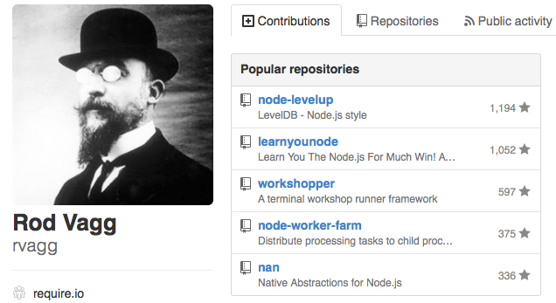
Thanks Rod Vagg!

Slide 27
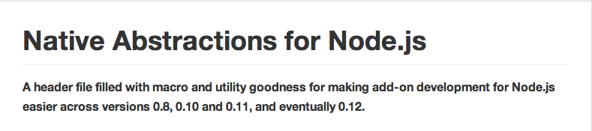

Slide 28
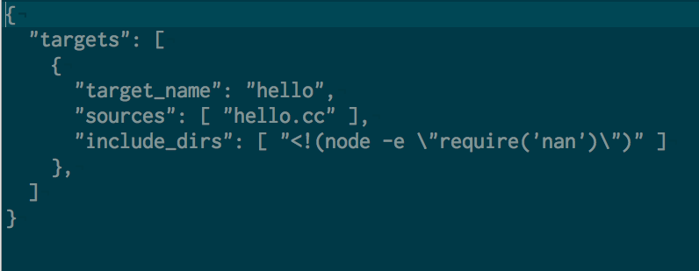

Slide 29
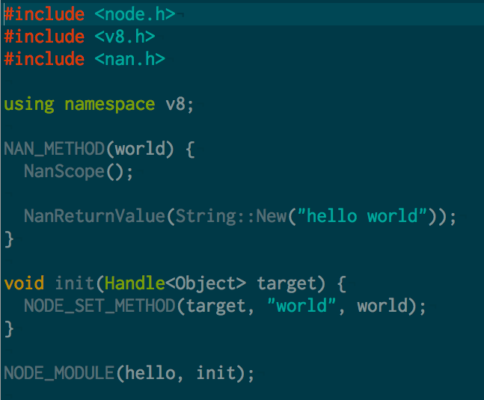
Notes:
Hail to the Macro
Gets rid of the differences between 0.10 and 0.11 yay
Define methods with NAN_METHOD
Use NanScope to hande the scope

Slide 30
What could go wrong?
Lets explore it by wrapping a C lib for murmur3 hashing
Notes:
- Lets look at some more parts of building an extension

Slide 31
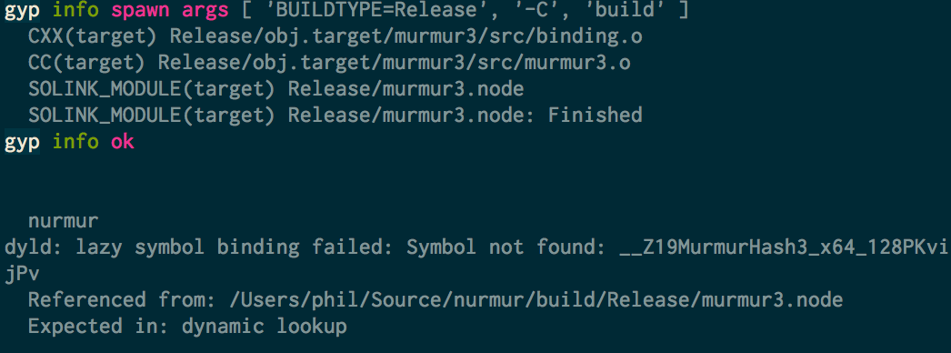
Wrapping C
Notes:
- Dynamic linker being helpful

Slide 32
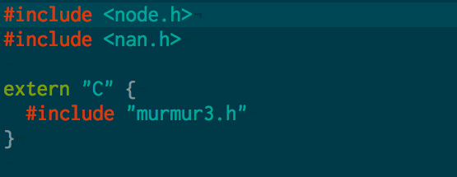
Notes:
- Make sure to declare that, not really a node thing but easily missed, and the linker as always is hardly helpful

Slide 33
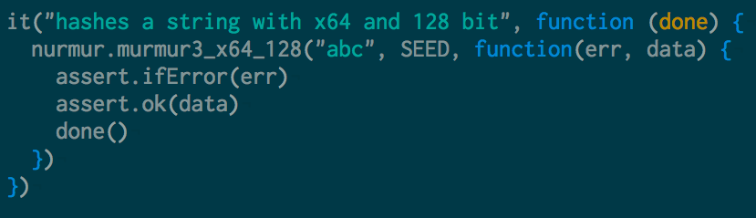
Arguments and callbacks

Slide 34
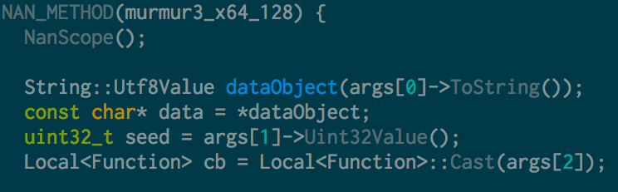
Notes:
You need to do the extraction yourself
You need to get the right types
Look you can even have a callback

Slide 35
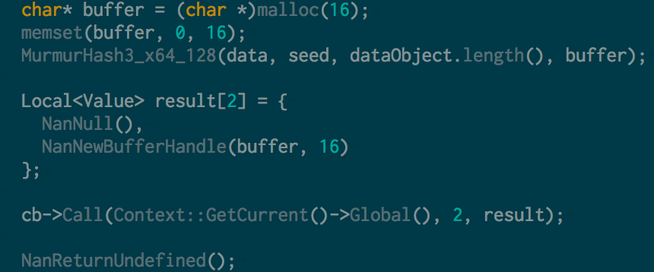
Notes:
Call the callback is straight forward really
You need to provide the context
Now you are ready for async
Just don’t touch v8 from outside the main thread!

Slide 36
Some more couchnode
To finish of…

Slide 37
What happens on a GET

Slide 38
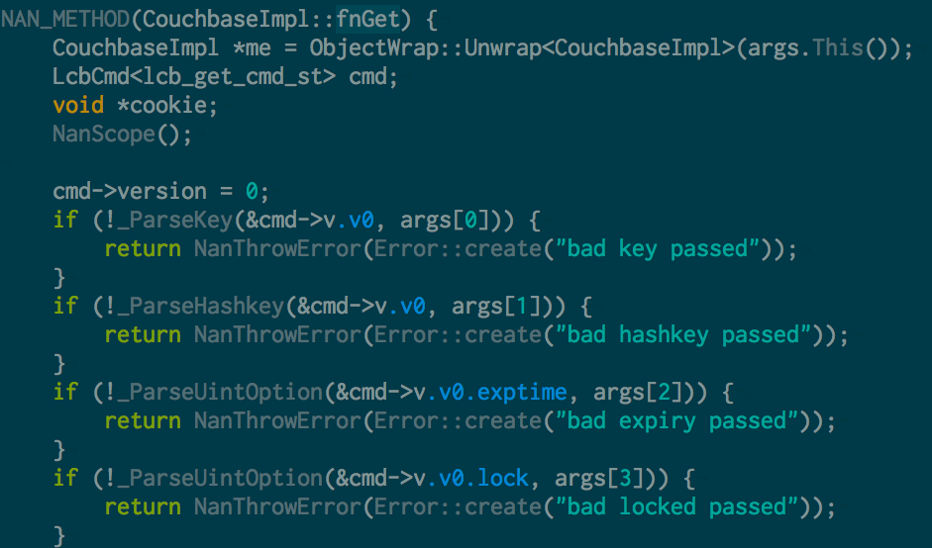
Notes:
This holds a reference to our couchbase struct so we can use it for our connection
Extract the arguments (ParseKey… and following mainly just do this and check the type)
Store the arguments in the way libcouchbase expect them

Slide 39
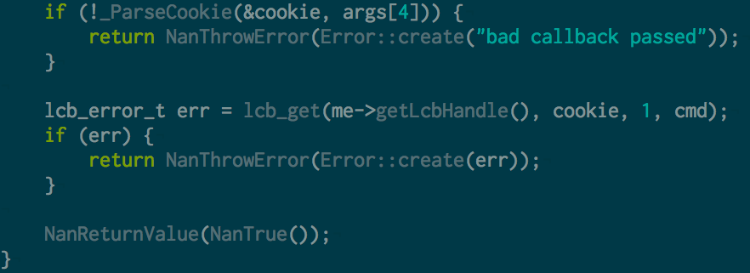
Notes:
Save off the callback (ParseCookie)
Call libcouchbase
Return and let libcouchbase handle the get and call the callback

Slide 40
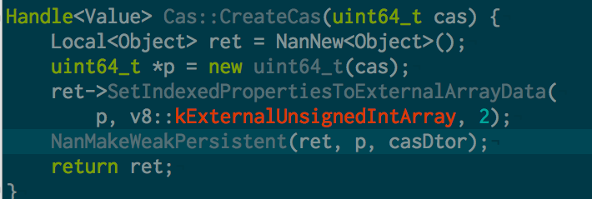
Why is cas an Array?
Notes:
And why you shouldn’t modify it
Or really look at it… it’s just an opague value seriously!

Slide 41

Checkout spanconf.io
Notes:
Come to spanconf
All about handling scale, for data and applications
Speed, data analysis, and how the grey beards do it (Erlang!)

Slide 42
Thank you!

Slide 43
Links
https://github.com/kkaefer/node-cpp-modules
https://github.com/TooTallNate/node-gyp
https://github.com/rvagg/nan
https://github.com/couchbase/couchnode
http://www.couchbase.com/communities/nodejs
https://github.com/sideshowcoder/nurmur/

